Slide 1


MoneyWise Expenses Tracker Application
Group B 57

Slide 2
INTRODUCTION
The purpose of a daily spending tracker system is to monitor an organization's income and expenses daily. The revenue is divided by this approach according to daily costs.
If they surpass the daily expenditures, the system will compute the users' revenue and generate fresh daily expenses.
After each month, the daily spending monitoring system will provide a report that displays revenue expenses as a doughnut chart.
With the help of the cost tracker software, users can effectively manage their spending and steer toward financial stability by keeping track of all their expenses.
It is simpler to observe how much money people spend when they track their expenditures on a weekly, monthly, and yearly basis.

Slide 3
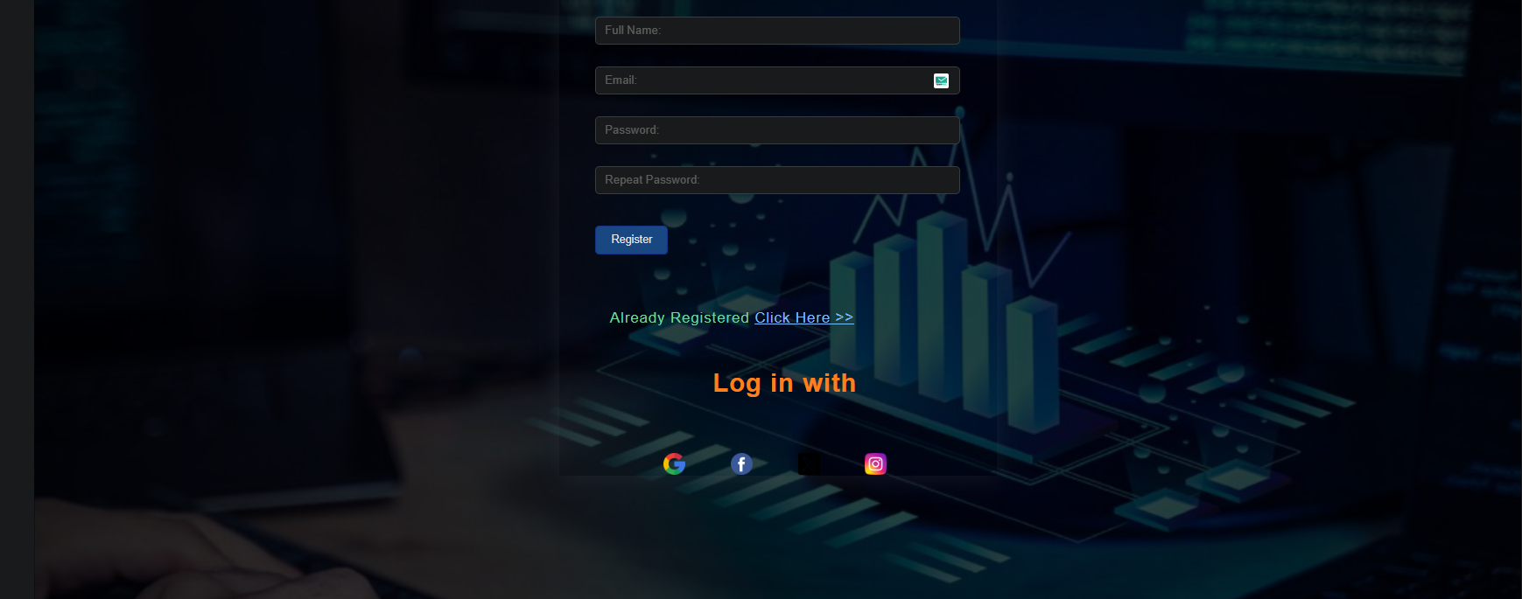
Sign Up

Slide 4
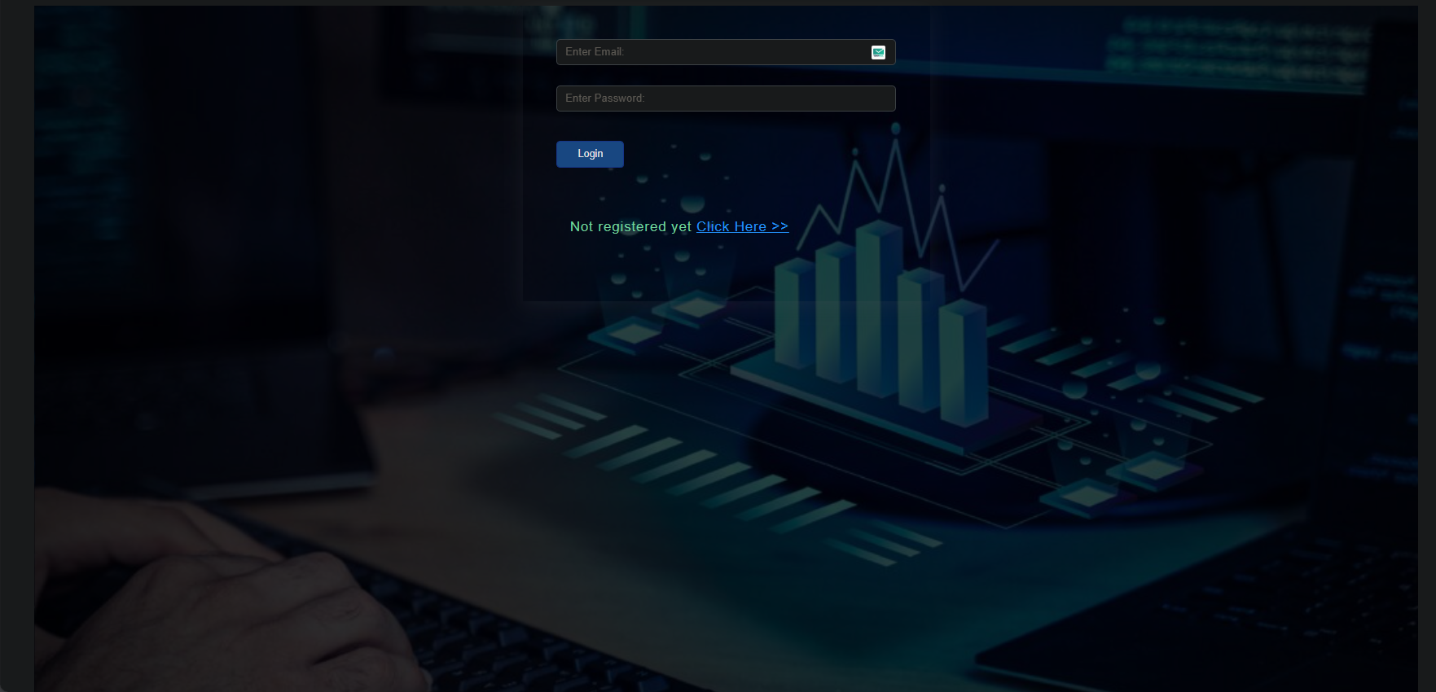
Sign In

Slide 5

Home

Slide 6
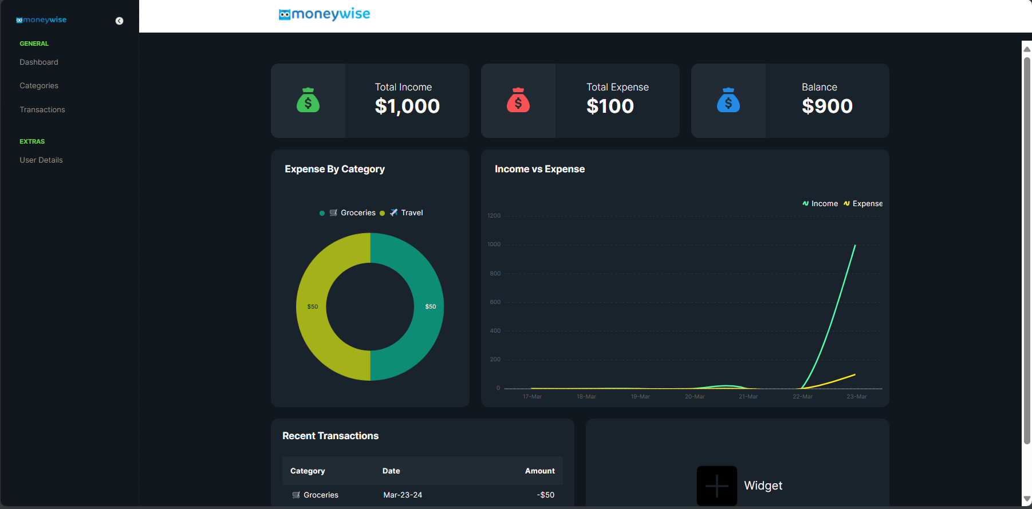
Dashboard

Slide 7
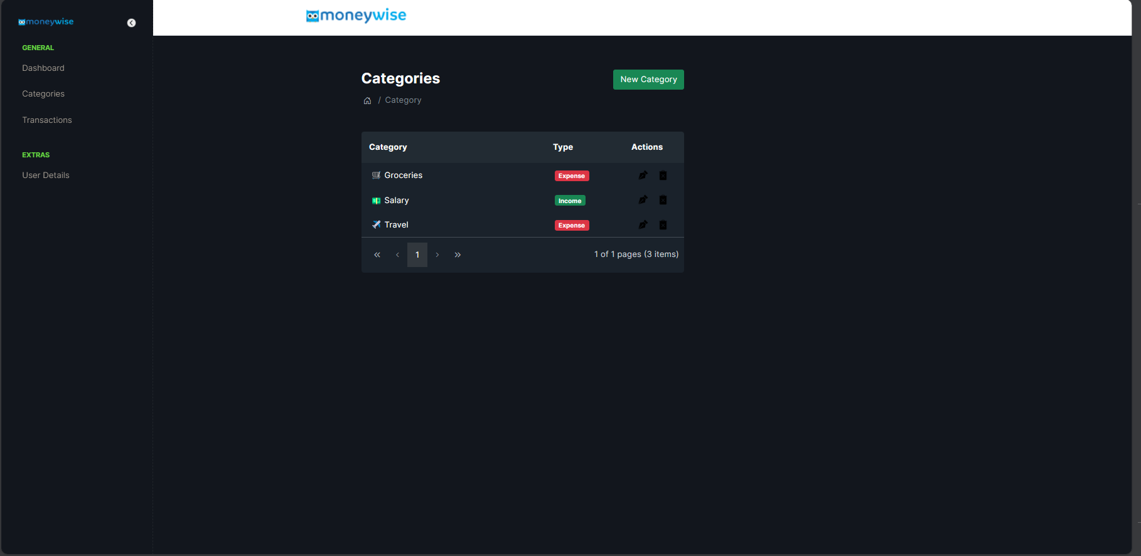
Categories

Slide 8
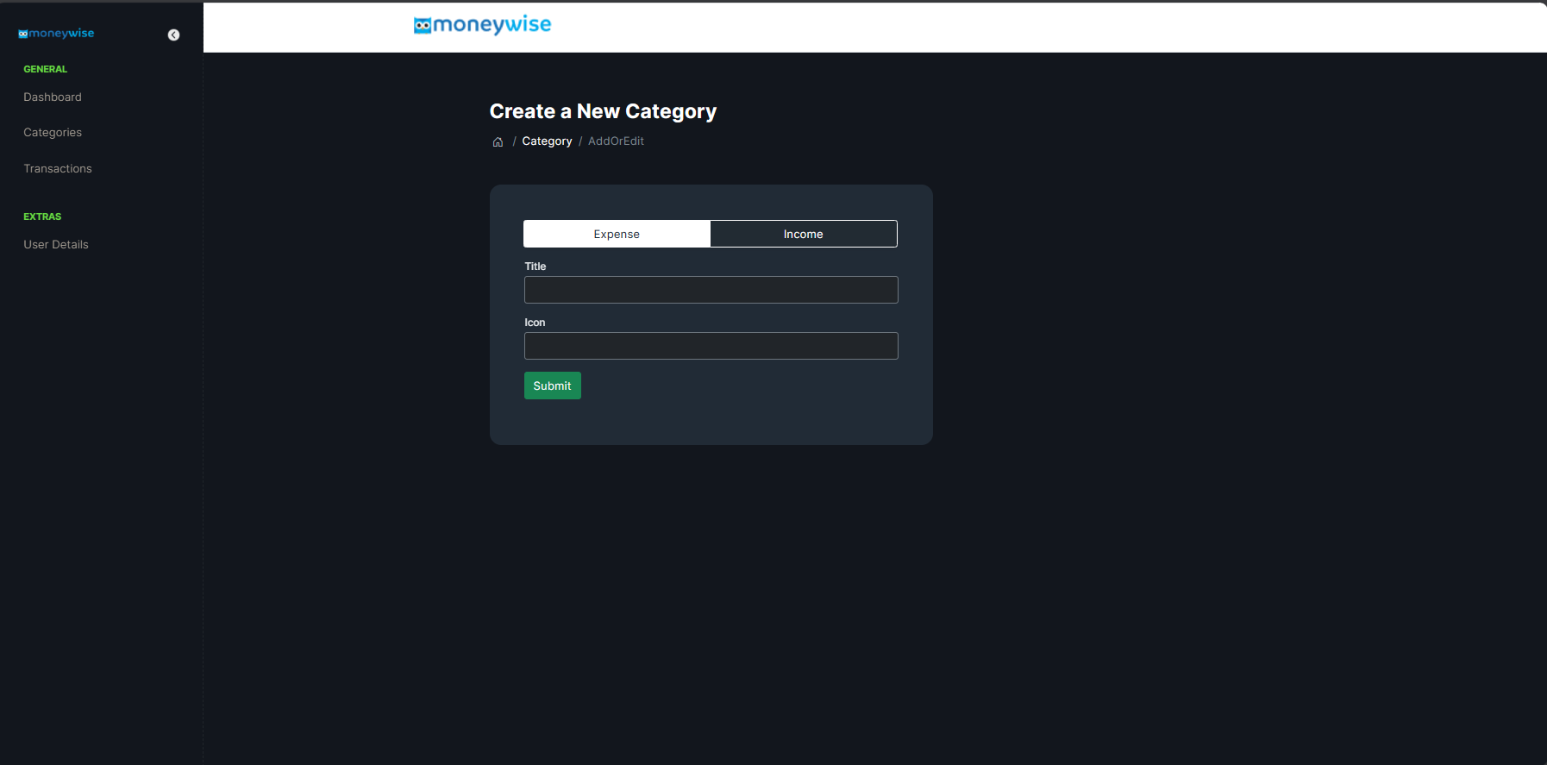
Add New Category

Slide 9
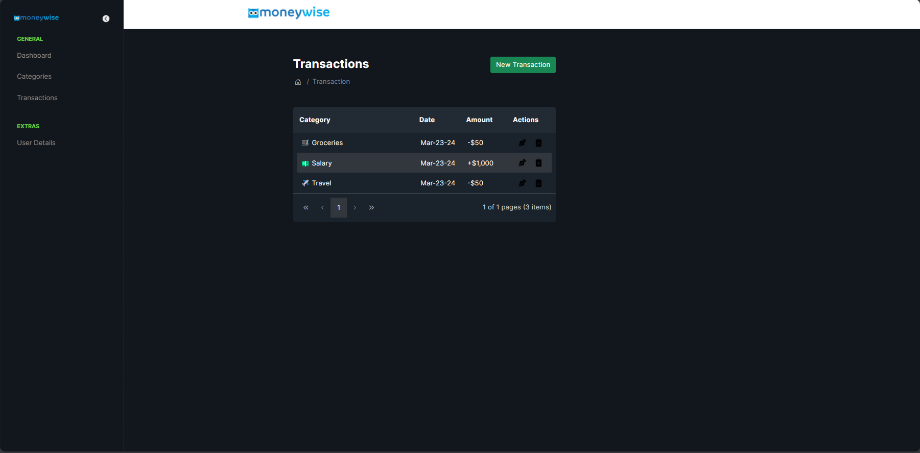
Transactions

Slide 10
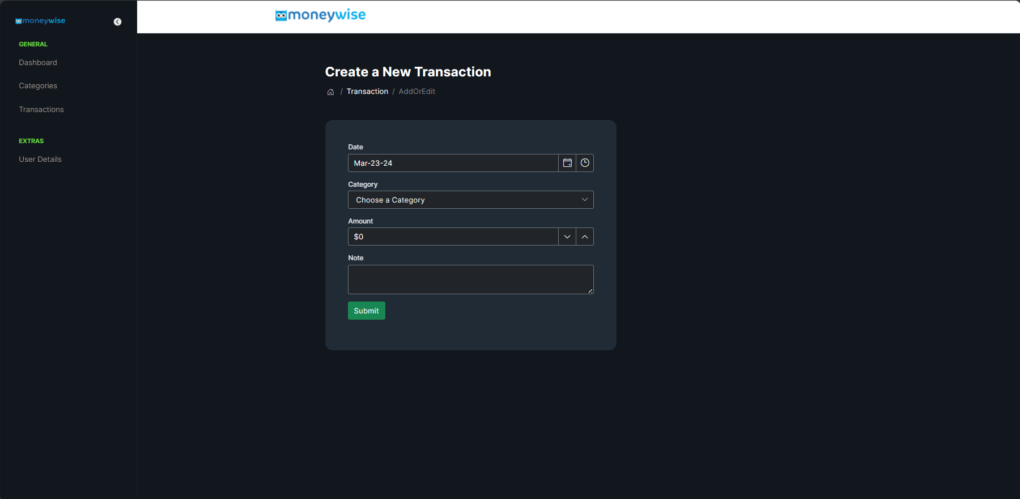
Add New Transaction

Slide 11
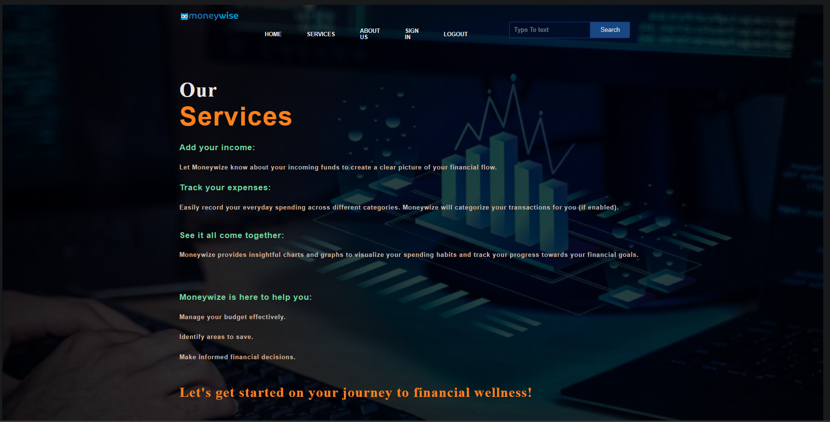
Services

Slide 12
Our Team
Name | Position | Index
Gajasinghe Gajasinghe | Group Leader | 10898764
Deshitha Bandara | Planning Leader and Testing Leader | 10899245
Rajakaruna Gunawardhana | Programing Leader | 10899273
Kavindu Kamalhewa | Technical Leader and Quality Leader | 10899292

